Slide 1


REAL-TIME, AI-ASSISTED FLAME STABILITY ANALYSIS
application to flame spray pyrolysis

Slide 2
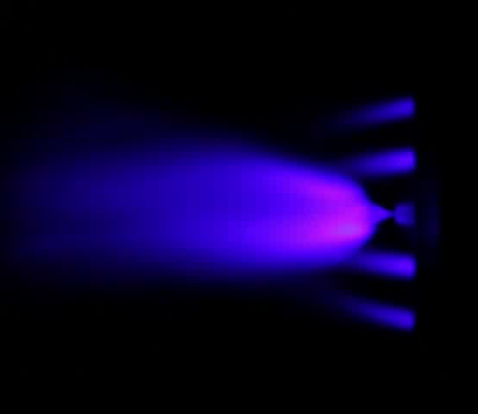
FLAME SPRAY PYROLYSIS
PROBLEM
Synthesis method for nanoparticle production in which sprayed solvent is combusted and powders are formed
Unstable flame conditions mean the results of the synthesis process may be unreliable

Slide 3
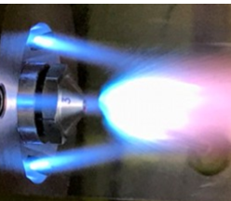

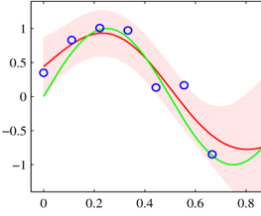
VISION: HUMANS AND SOFTWARE PERFORM A REAL-TIME OPTIMIZATION OF A SYNTHESIS PROCESS
Data Collection
Flame Spray
Pyrolysis
Machine Learning Develops Model
Intelligent Python software drives optimization
Active Learning
M. Stan et. al, 2019, in preparation

Slide 4
TIME
RESOURCES
SAFETY
Is $$$
Is also $$$
!($$$ < 0)

Slide 5
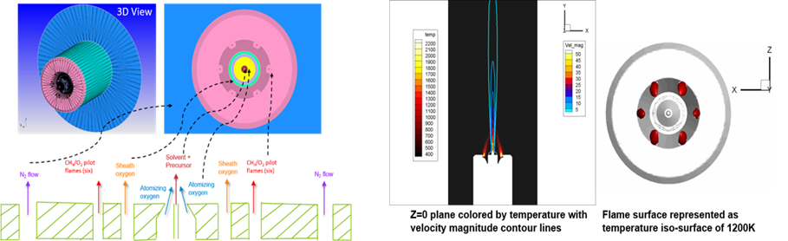
CFD MODELING
Schematic of FSP reactor setup
D. Dasgupta et. al, 2019, in preparation
Sample results for pilot flame stabilization

Slide 6
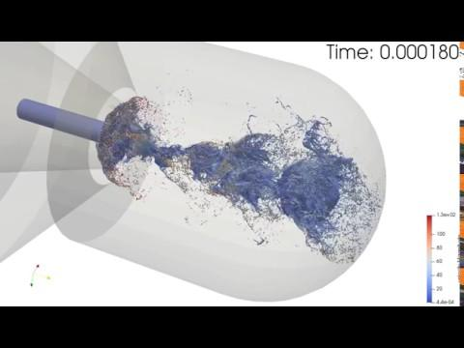
CFD MODELING
D. Dasgupta et. al, 2019, in preparation

Slide 7

Reading papers about physics behind FSP...
Source: Unknown

Slide 8
TOOLS / APPROACH
Python (OpenCV, Scikit-Learn, Scipy, Numpy, Pandas), Tensorflow, CUDA

Slide 9
METHODOLOGIES
Stability Classification
Unsupervised Machine Learning
Supervised Machine Learning

Slide 10
STABILITY CLASSIFICATION
1
Objective: quantitatively determine flame stability using video features
Compare measurements of expert accounts to determine best means of quantifying stable vs. unstable flames

Slide 11

Example #1
Stable Flame

Slide 12
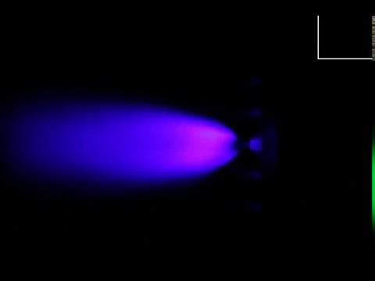
Example #2
Unstable Flame

Slide 13
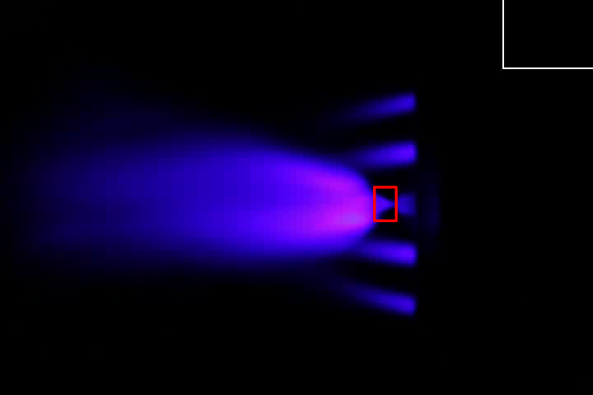
Stability Indicator #1
Bounding Box

Slide 14
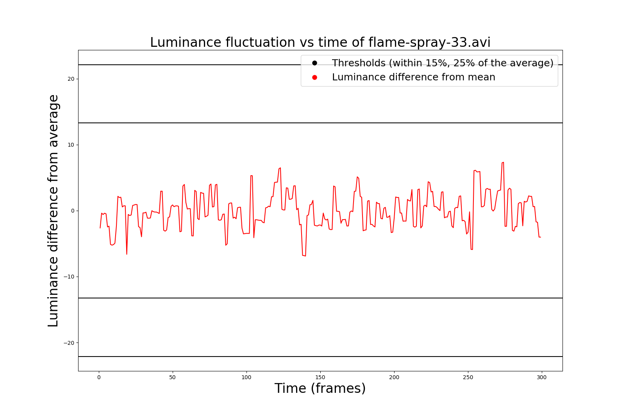
LUMINANCE FLUCTUATION VARIES WITH TIME
stable

Slide 15
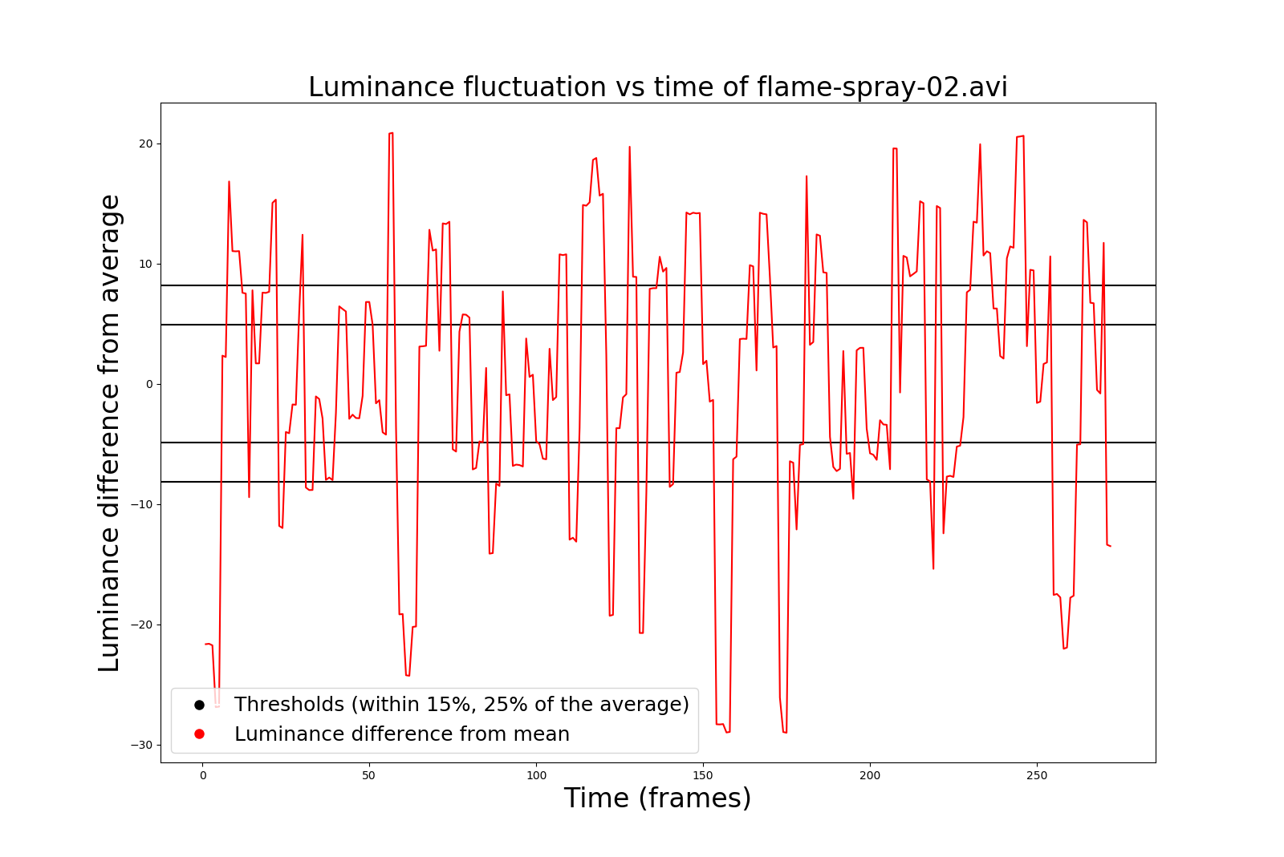
LUMINANCE FLUCTUATION VARIES WITH TIME
unstable

Slide 16
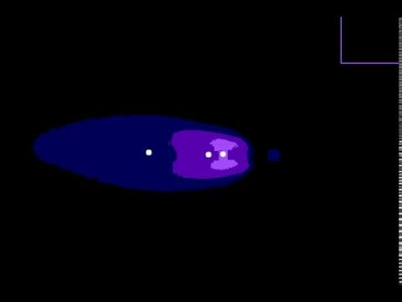
Stability Indicator #2
Centroid Analysis

Slide 17
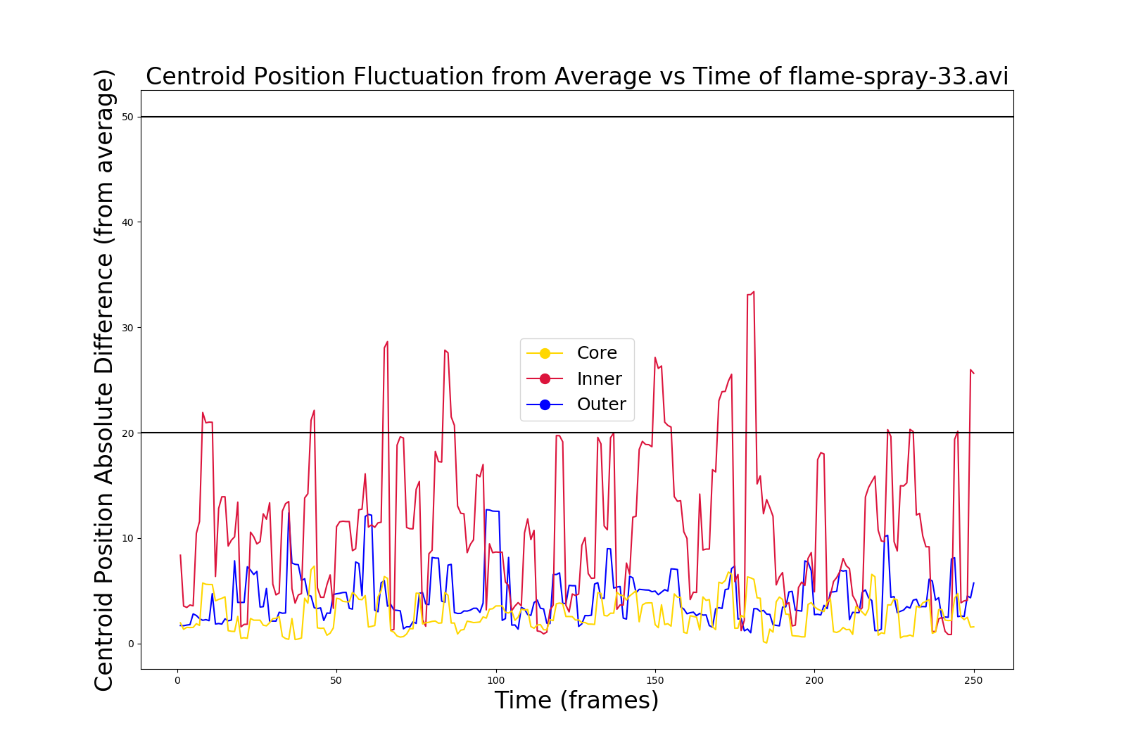
CENTROID POSITION FLUCTUATION VARIES WITH TIME
stable

Slide 18
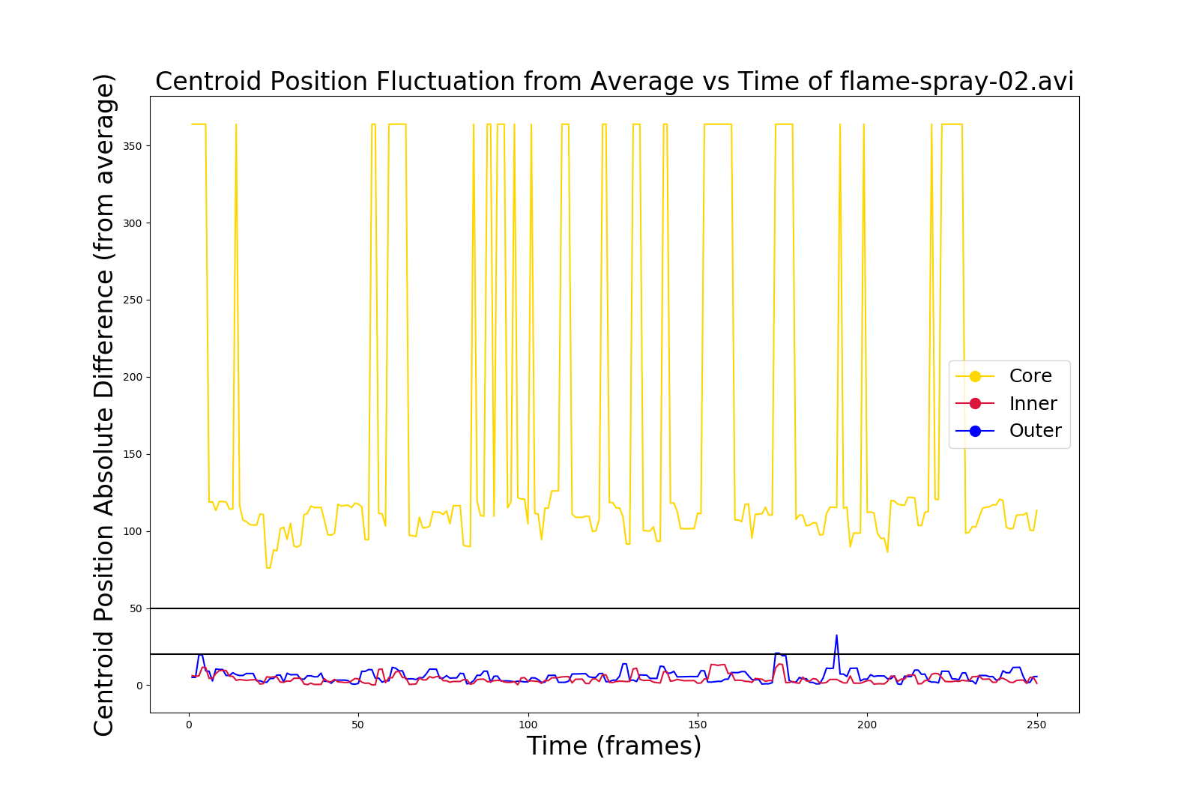
CENTROID POSITION FLUCTUATION VARIES WITH TIME
unstable

Slide 19
COMPARISON OF RESULTS WITH EXPERT OPINIONS
Jessica
Debolina
Dante
Joe

Slide 20
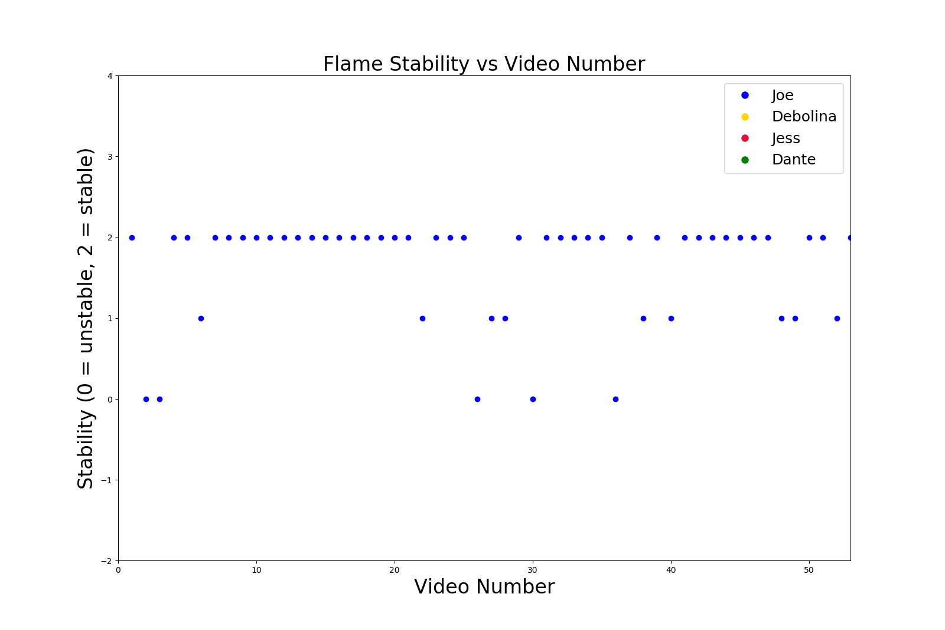
EXPERTS PROVIDE STABILITY EVALUATIONS
experts

Slide 21
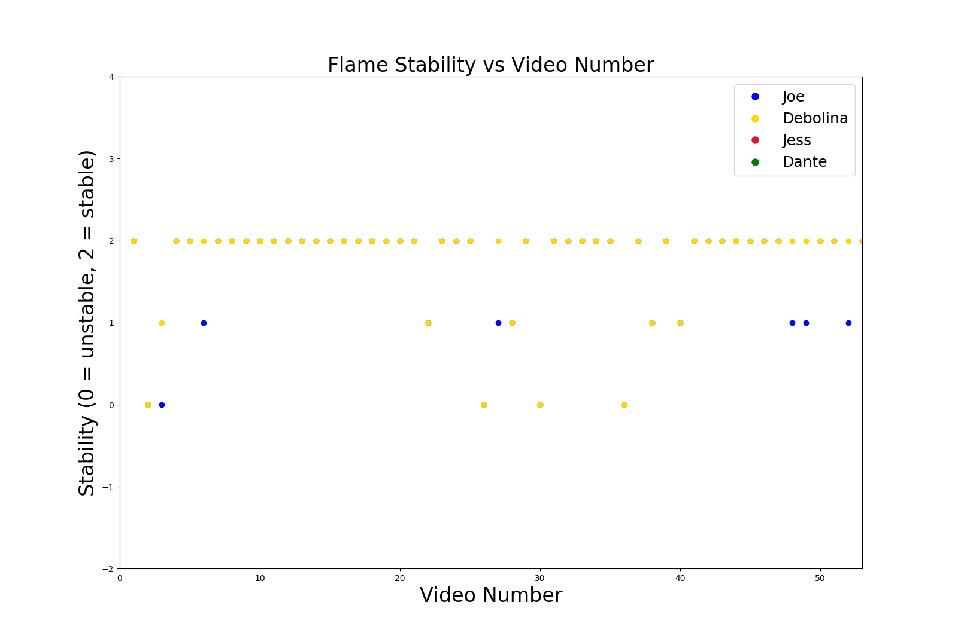
EXPERTS PROVIDE STABILITY EVALUATIONS
experts

Slide 22
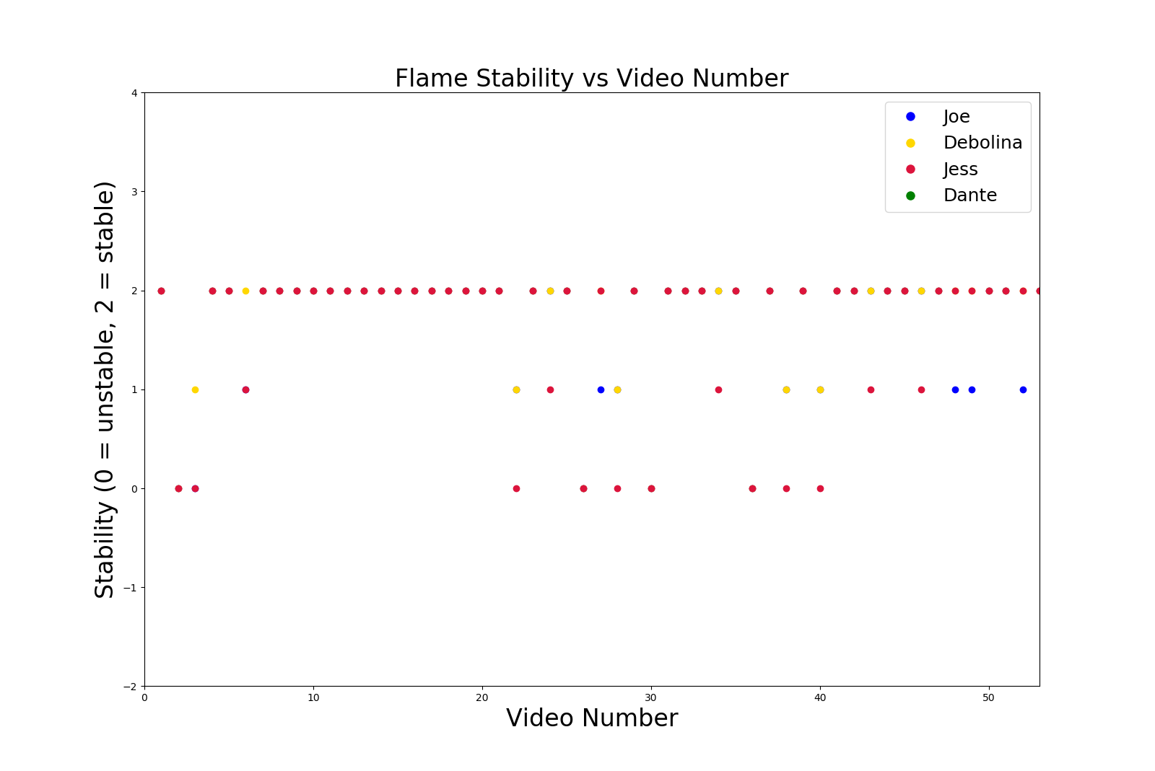
EXPERTS PROVIDE STABILITY EVALUATIONS
experts

Slide 23
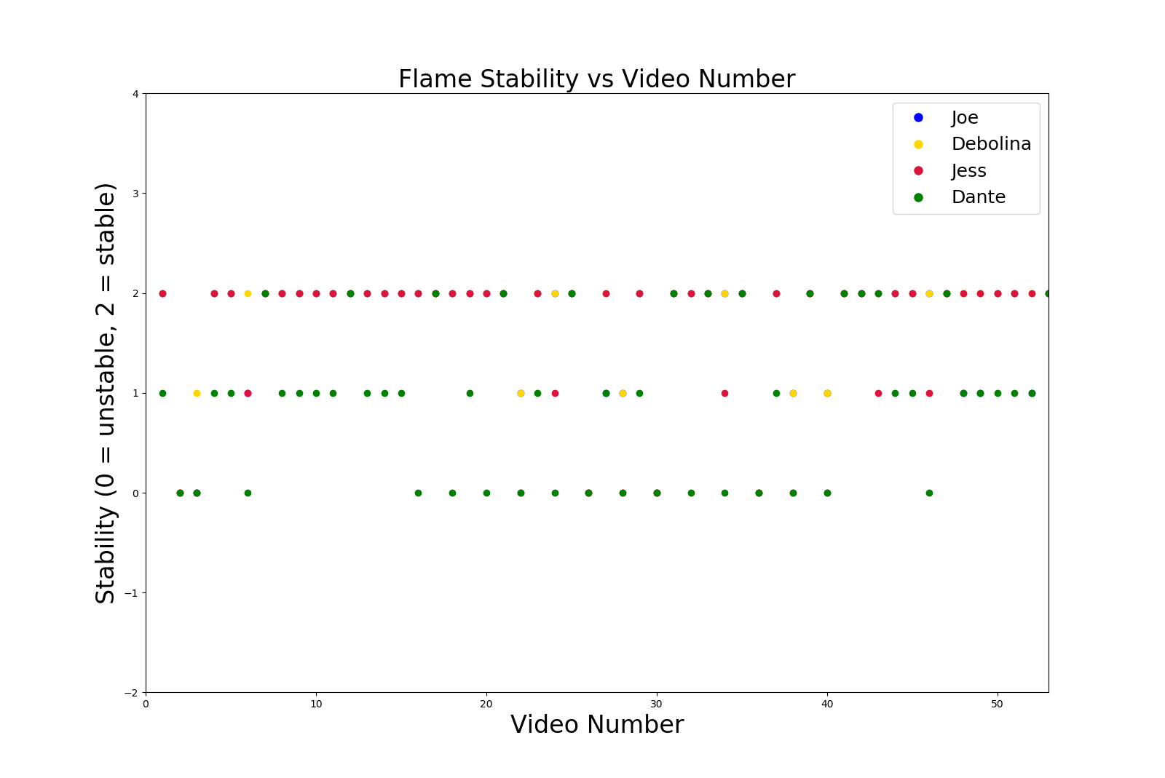
EXPERTS PROVIDE STABILITY EVALUATIONS
experts

Slide 24
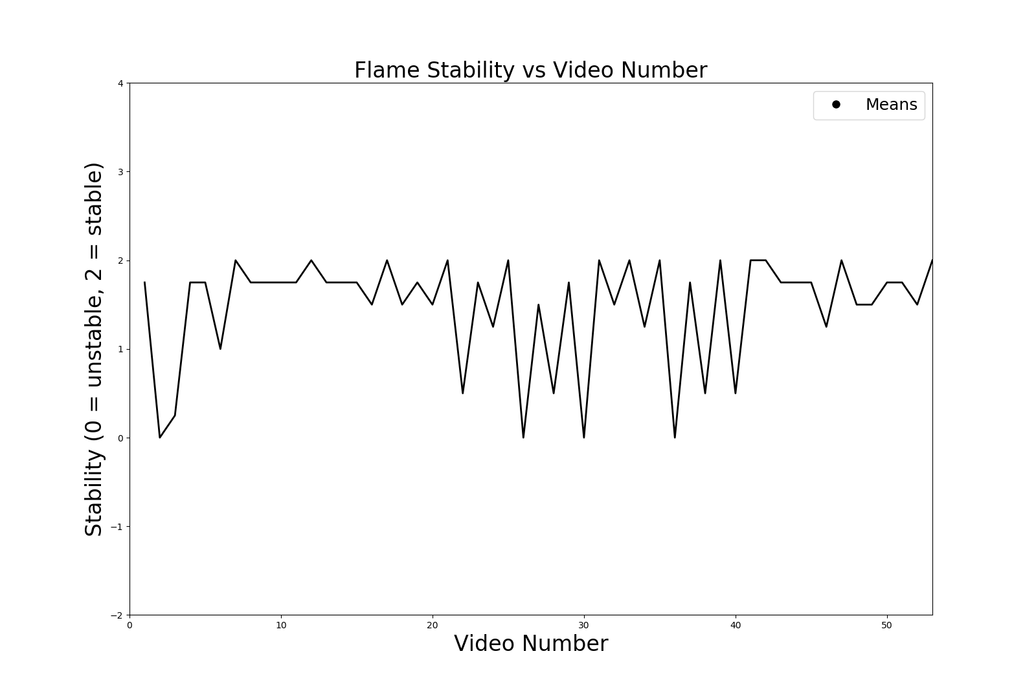
COMPARISON OF RESULTS WITH EXPERT EVALUATIONS
experts

Slide 25
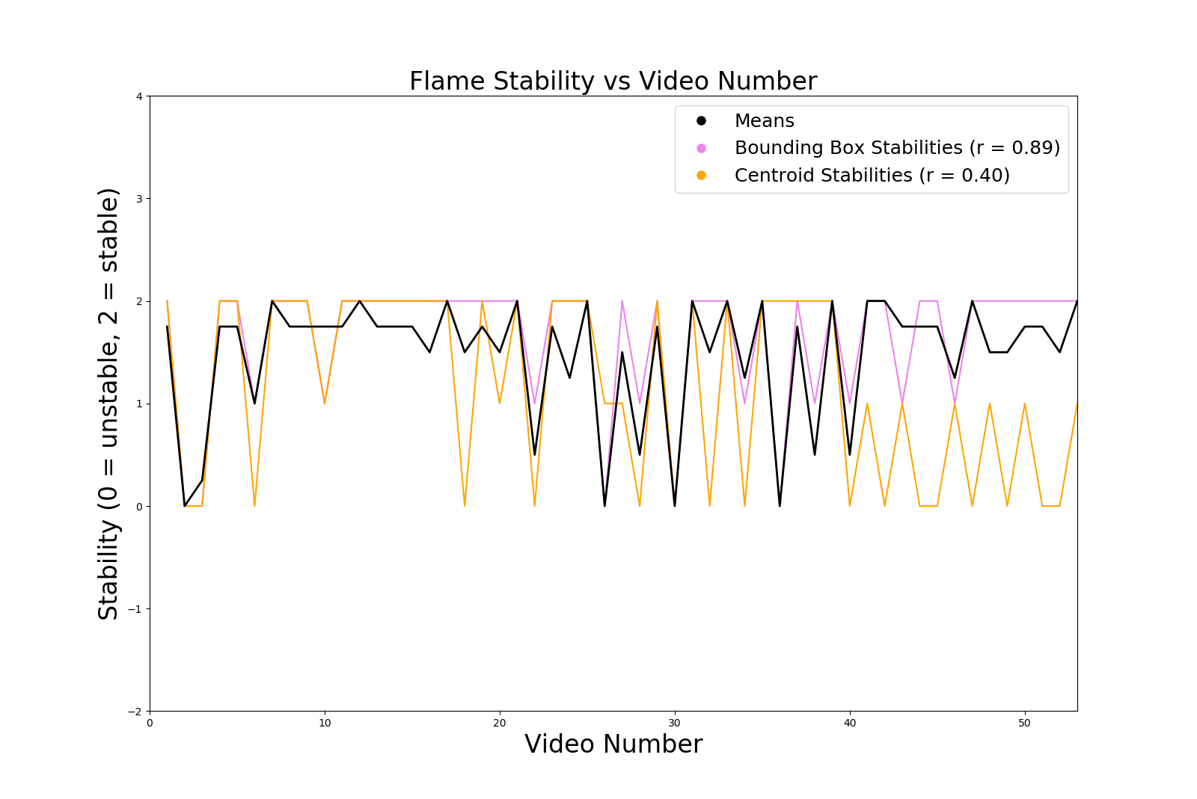
COMPARISON OF RESULTS WITH EXPERT EVALUATIONS
experts

Slide 26
UNSUPERVISED MACHINE LEARNING
2
Objective: to see if an algorithm can learn (by itself) the difference between a stable and unstable flame
Principal component analysis on a number of inputs / features

Slide 27
Principal Component Analysis
Dimensionality Reduction Technique
Lots of features
Find orthogonal directions in the data that explain a maximum amount of variance
Fewer features

Slide 28
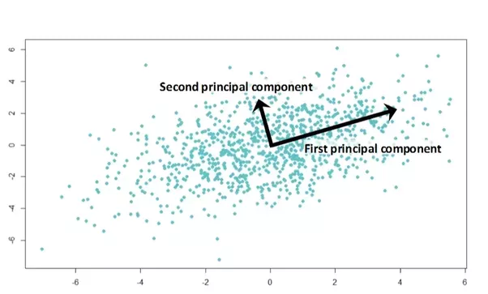
Principal Component Analysis
https://medium.com/@sadatnazrul/the-dos-and-donts-of-principal-component-analysis-7c2e9dc8cc48

Slide 29
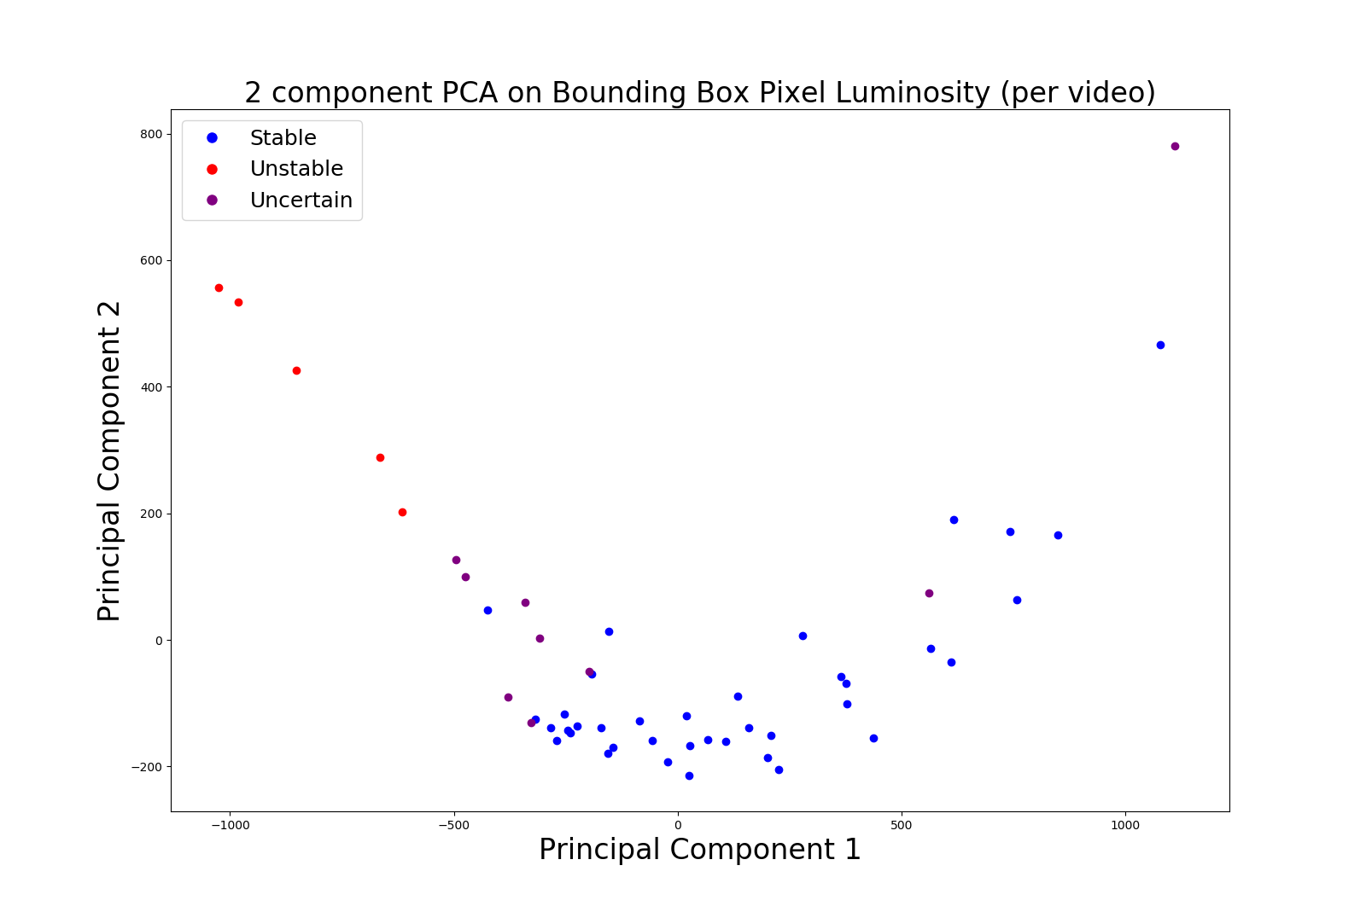
PCA RESULTS CAN BE CLUSTERED INTO STABLE VS UNSTABLE REGIONS
Explained variance: 61%, 13%
PCA

Slide 30
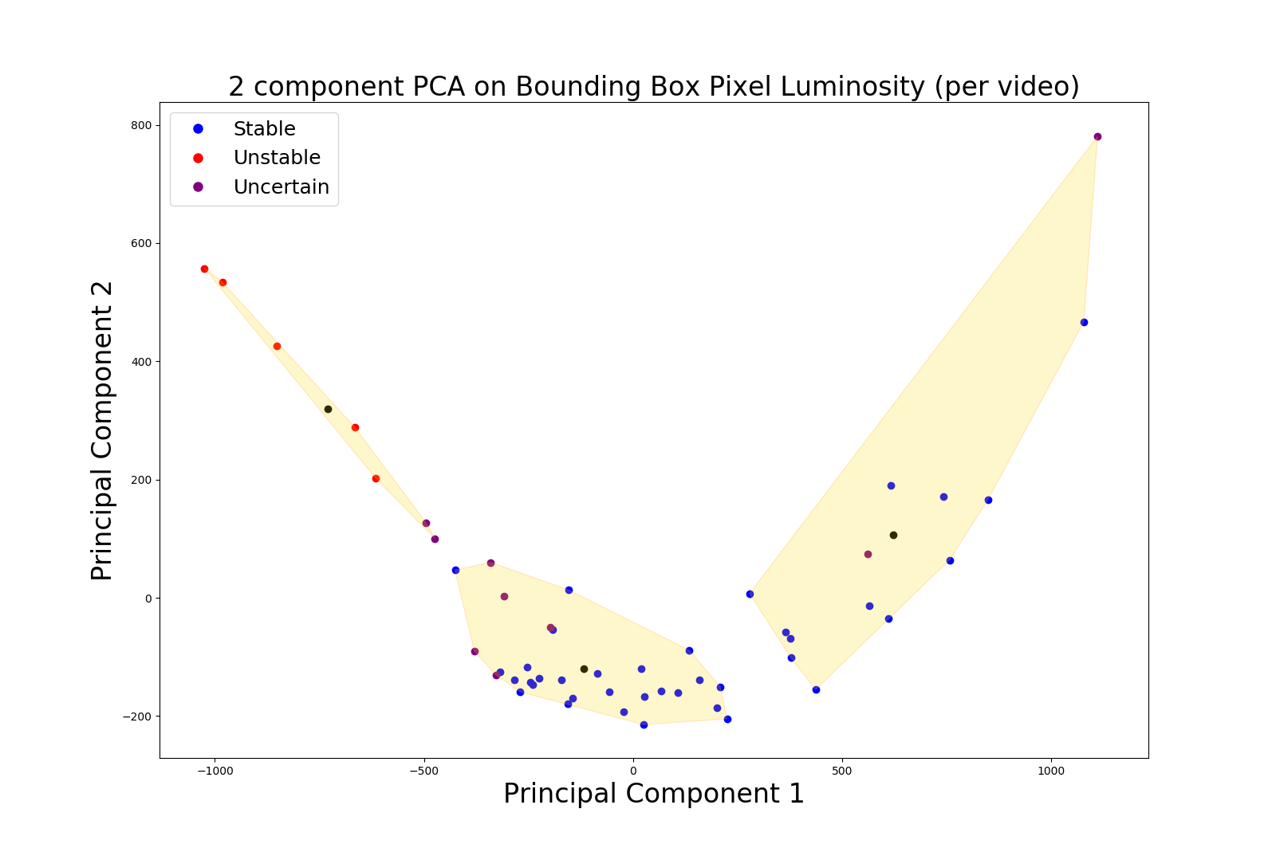
PCA RESULTS CAN BE CLUSTERED INTO STABLE VS UNSTABLE REGIONS
Explained variance: 61%, 13%
PCA

Slide 31
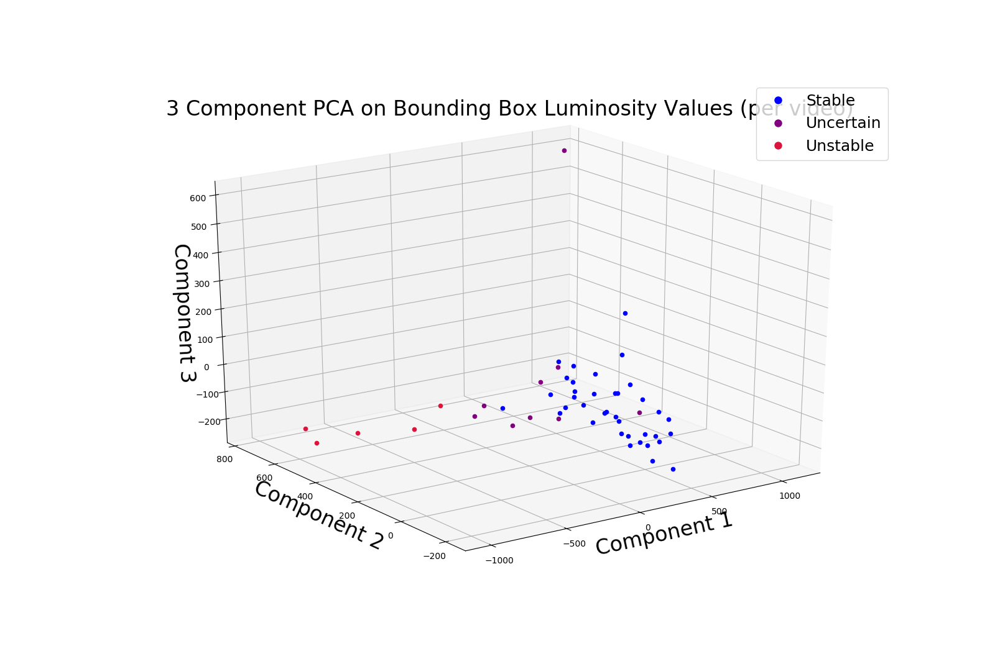
PCA RESULTS CAN BE CLUSTERED
PCA
Explained variance: 61%, 13%, 6%

Slide 32
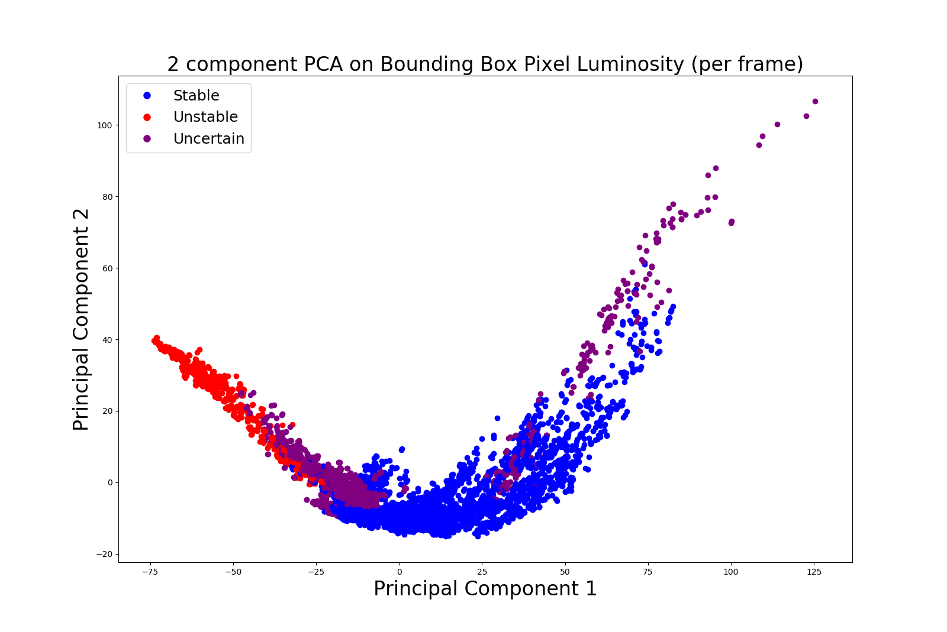
PCA RESULTS CAN BE CLUSTERED INTO STABLE VS UNSTABLE REGIONS
PCA
Explained variance: 61%, 14%

Slide 33
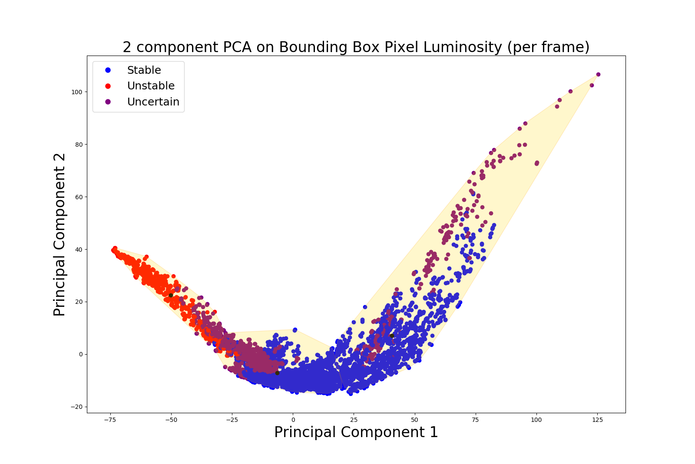
PCA RESULTS CAN BE CLUSTERED INTO STABLE VS UNSTABLE REGIONS
Explained variance: 61%, 13%
PCA

Slide 34
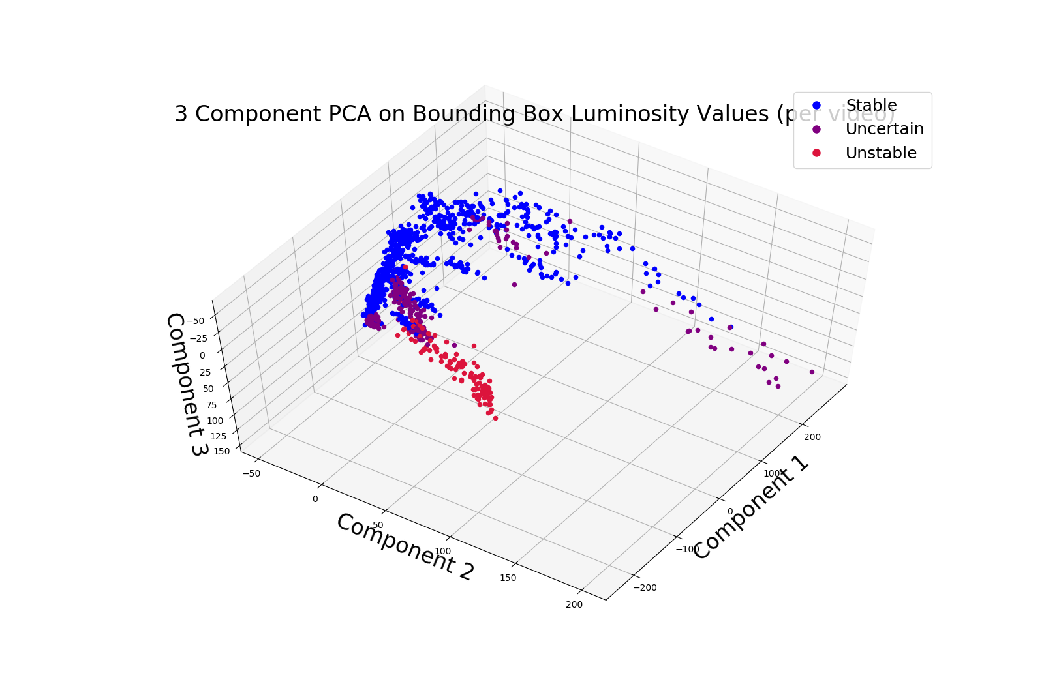
PCA RESULTS CAN BE CLUSTERED INTO STABLE VS UNSTABLE REGIONS
PCA
Explained variance: 61%, 14%, 7%

Slide 35
SUPERVISED MACHINE LEARNING
3
Objective: real-time detection and alert for flame instability
Convolutional neural network data gathering and training

Slide 36
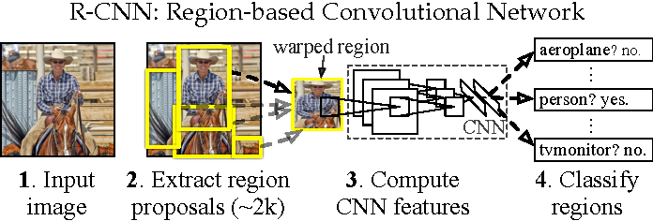
REGION-BASED CONVOLUTIONAL NEURAL NETWORK
Girshick, R.B., Donahue, J., Darrell, T., & Malik, J. (2016). Region-Based Convolutional Networks for Accurate Object Detection and Segmentation. IEEE Transactions on Pattern Analysis and Machine Intelligence, 38, 142-158.

Slide 37
Training/Test Set: ~570 images incrementally picked from video clips
Number of classes: 4
Pilot flame
Stable [flame]
Unstable [flame]
Burner Cap
Training time: ~13 hours
https://github.com/EdjeElectronics/TensorFlow-Object-Detection-API-Tutorial-Train-Multiple-Objects-Windows-10

Slide 38
Results
Stable Flame

Slide 39
Results
Unstable Flame

Slide 40
Results
Unstable Flame Warning

Slide 41
Conclusion
Bounding box can be good indicator of flame stability
PCA results yield stable vs unstable clusters
Object detection of unstable flame condition is fruitful

Slide 42

Source: Unknown

Slide 43
Future Steps
YOLO Object Detection Model
Autonomous Correction with Object Detection Results
Integration of Dante’s Work

Slide 44





Acknowledgements
Special thanks to everyone who made this experience and research possible:
Marius Stan, Noah Paulson, Dante Gil-Marin, Joe Libera, Debolina Dasgupta, Python, Tensorflow, EdjeElectronics
EERE Robotics Program, ORISE, DOE, Argonne National Laboratory, Lisa Reed, Stephanie Kendzora
Liliana Stan, John Murphy, Young Soo Park
Fellow Argonne Interns :)

Slide 45
THANK YOU!
Stability Classification
Unsupervised Machine Learning
Supervised Machine Learning
Example FSP Videos
Bounding Box
Centroid Analysis
Experts Provide Flame Stability Evaluations
Principal Component Analysis Explanation
PCA Results Can Be Clustered (per Video)
PCA Results Can Be Clustered (per Frame)
RCNN Explanation
Training Method
Results: Stable Flame
Results: Unstable Flame
Unstable Flame Warning

